Slide 1
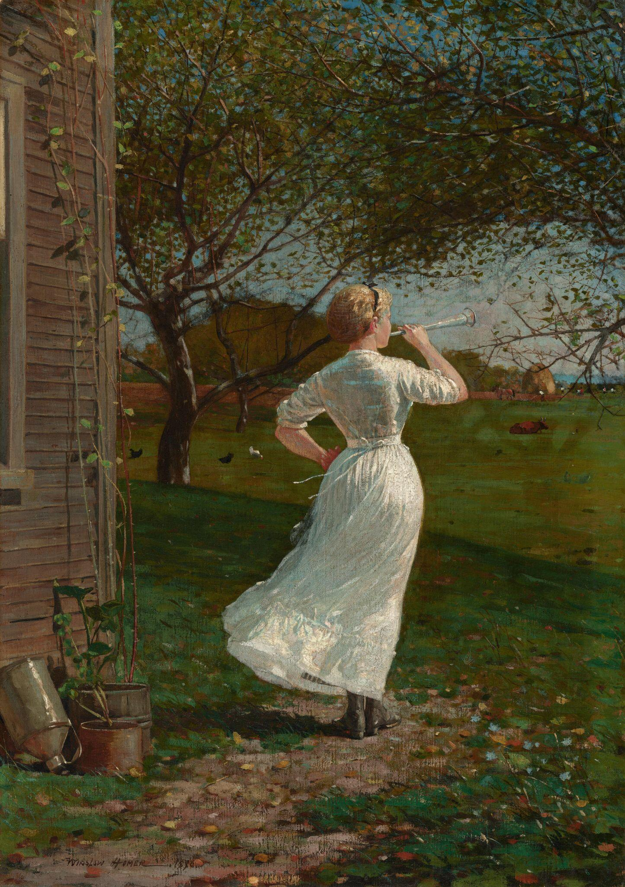




Generating Music from Paintings
Presentation 2
Presented By
Dina Ahmed El Sayed Fathy
Supervised By
Prof Doc Mohamed Abo Rezka
Winslow Homer The Dinner Horn (Blowing the Horn at Seaside), 1870

Slide 2
Table of contents
01
02
03
04
Introduction
Algorithm to Implement
Main Idea
Challenges
Applications
Accomplishments and Next Steps
AI Models and Dataset

Slide 3

Introduction

Slide 4
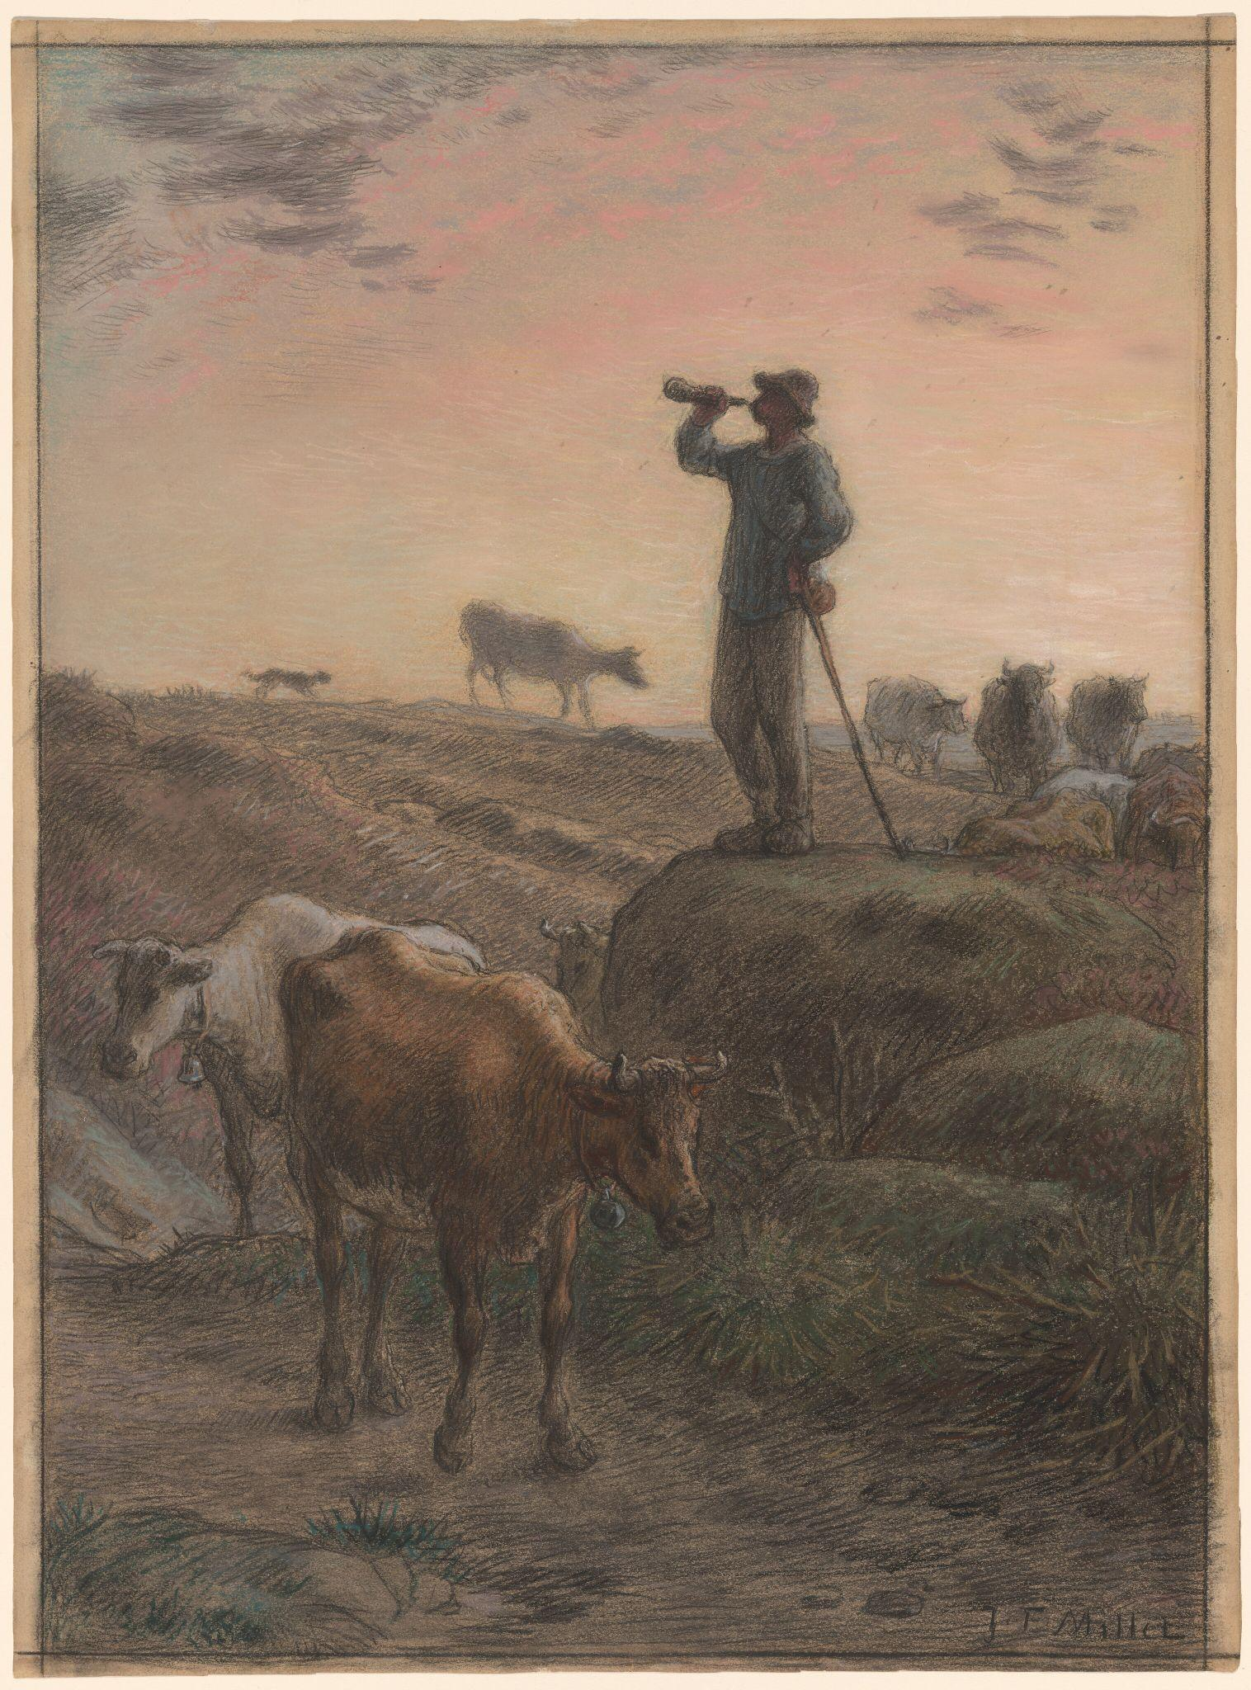
Main Idea
Is to create music that describes paintings and to answer this question
“How Does that image sound”?
Jean-François Millet Calling Home the Cows, c. 1866

Slide 5

Challenges
Evaluation Complexity
Integration
Jean-François Millet Calling Home the Cows, c. 1866

Slide 6
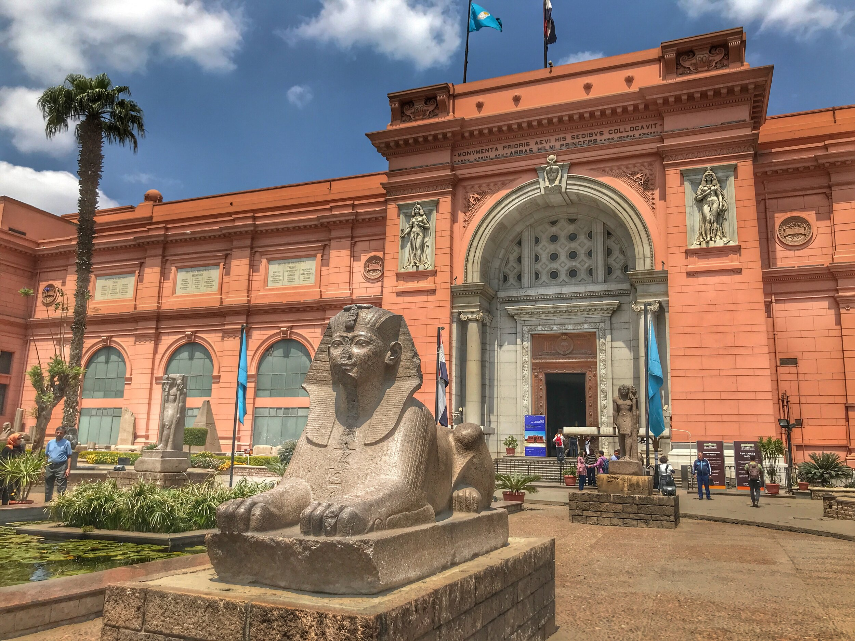
Applications
Accessibility in Museums for the Visually Impaired

Slide 7
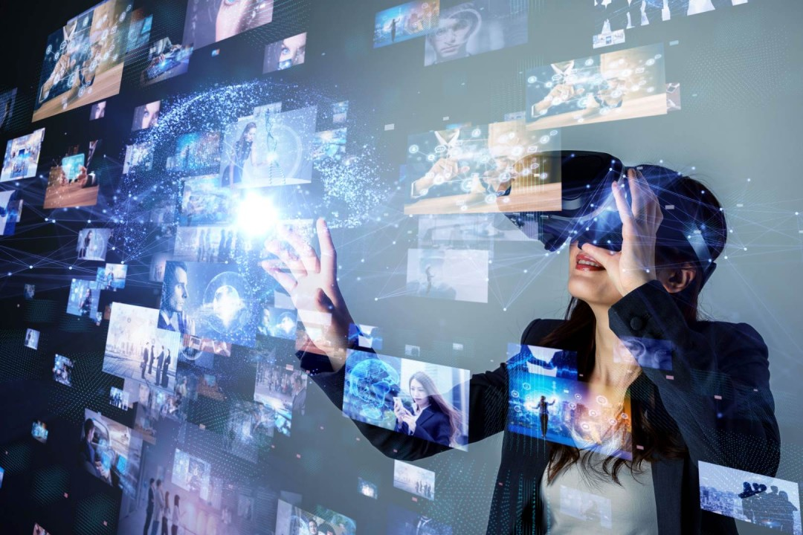
Applications
2.Content Creation for Media

Slide 8

Applications
3.Therapatic Tools

Slide 9
Algorithm to Implement

Slide 10
Algorithm
1
Dataset Preparation
Prepare image dataset which is WikiArt
Prepare audio dataset which is [Mirex Emotion Dataset]

Slide 11
Algorithm
1
2
3
Dataset Preparation
Emotion Labelling Model
Generate Text from Image
Prepare image dataset which is WikiArt
Prepare audio dataset which is [Mirex Emotion Dataset]
Classify Images into emotion using Resnet 50 model
Using Transformers model like BLIP

Slide 12
Algorithm
4
Enhance Captions with Musical Terms
Use Large Language Model(LLM) and include details about mood ,genre,tempo and melody to create descriptions suitable for music generation

Slide 13
Algorithm
4
5
Generating Music
Enhance Captions with Musical Terms
Use Large Language Model(LLM) and include details about mood ,genre,tempo and melody to create descriptions suitable for music generation
Text Input: Enhanced captions with emotions and musical terms.
Audio Output: Corresponding music.

Slide 14
Algorithm
4
5
Generating Music
Enhance Captions with Musical Terms
Use Large Language Model(LLM) and include details about mood ,genre,tempo and melody to create descriptions suitable for music generation
Text Input: Enhanced captions with emotions and musical terms.
Audio Output: Corresponding music.

Slide 15
Algorithm
4
5
6
Generating Music
Train and Fine Tunning
Enhance Captions with Musical Terms
Use Large Language Model(LLM) and include details about mood ,genre,tempo and melody to create descriptions suitable for music generation
Text Input Enhanced captions with emotions and musical terms.
Audio Output: Corresponding music.
Train the music generation pipeline using the curated dataset.
Apply optimization techniques

Slide 16
Algorithm
Step-by-Step Implementation for Music Generation from Images
1. (First Priority)
Image Dataset:
Use an art dataset like the WikiArt Emotion Dataset to collect paintings.
Categorize paintings by emotion labels (e.g., Happy, Sad, Angry).
Manually validate to ensure the emotion categories accurately reflect the image content.
Music Dataset:
Use an emotion-labeled music dataset, such as the MIREX Emotion Dataset.
Convert MIDI files to WAV format at a compatible frequency (e.g., 32kHz) for audio models.
Preprocess audio into fixed-length chunks (e.g., 30 seconds).
Pairing Data:
Match each image with a corresponding music piece sharing the same emotion label to form image-music pairs.
2. Image to Emotion Mapping
Train a model to classify the emotion of each image using a pre-trained ResNet50 model.
Fine-tune the model with additional layers (e.g., GRU + attention) for improved emotion detection.
3. Image Captioning
Use a captioning model like BLIP to generate textual descriptions of the images.
Combine image features and emotion labels to generate emotionally relevant captions.
4. Enhance Captions with Musical Descriptions
Use a language model (e.g., FalconRW-1B) to enrich captions with musical terms like mood, genre, tempo, and style.
5. Music Generation
Fine-tune a model like MusicGen with paired text-audio data:
Text Input: Enhanced captions with emotions and musical terms.
Audio Output: Corresponding music.
Use pre-trained music generation models to reduce computational requirements.
6. Training and Fine-Tuning
Train the music generation pipeline using the curated dataset.
Apply optimization techniques like:
Freezing early layers.
Using precomputed tensors.
Fine-tuning parameters to align outputs with input descriptions.
7. Evaluation
Use metrics like FAD, CLAP, KL Divergence, and THD to evaluate the alignment and quality of generated music with the input images and captions.
8. Inference
During inference, use trained models to generate music from new images:
Detect emotions and generate captions.
Convert captions into musical compositions.
Refine parameters for real-time application.
7
Evaluation
Use metrics like FAD, CLAP, KL Divergence, and THD to evaluate the alignment and quality of generated music with the input images and capti

Slide 17
AI Models and Datasets

Slide 18
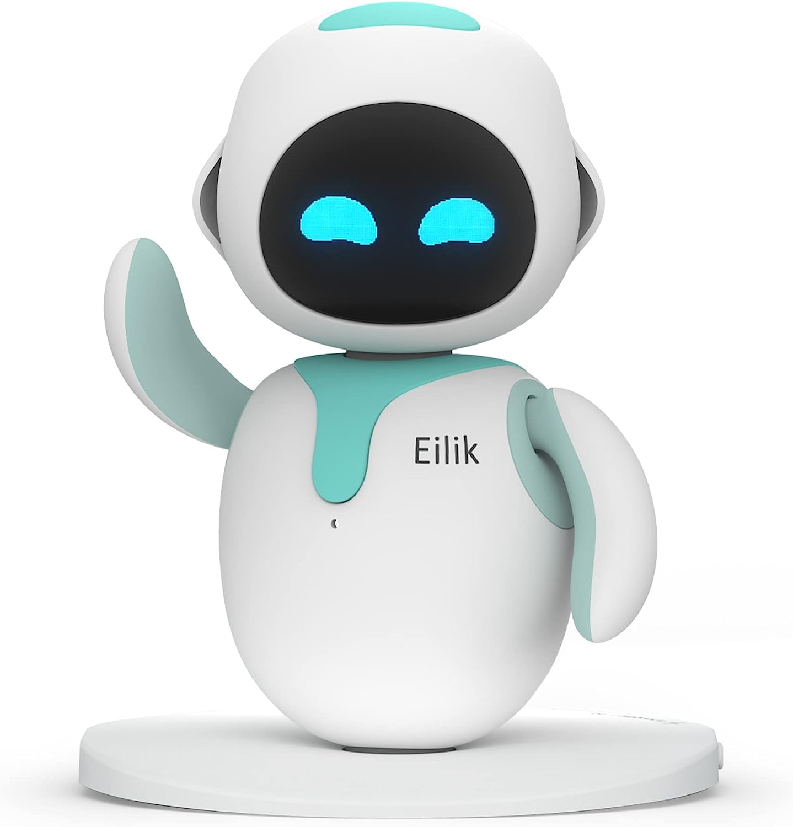
AI Models

Slide 19
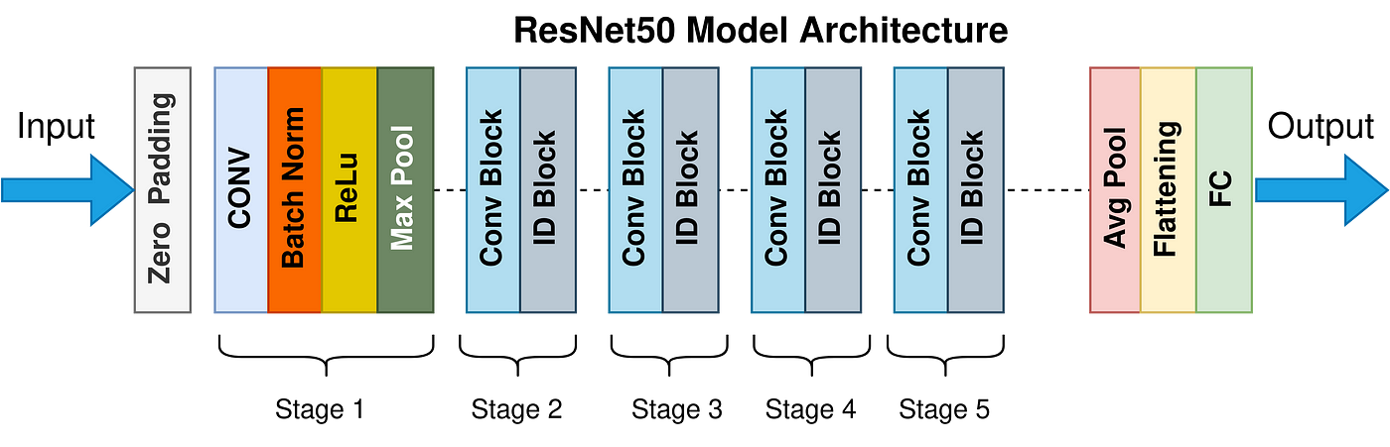
ResNet 50
Is a deep convolutional neural network (CNN) designed for image classification tasks.
It employs a residual learning approach, where each layer aims to learn the residual function with respect to the previous layer's output.
This approach helps alleviate the vanishing gradient problem and allows the network to learn deeper representations

Slide 20
Implementation
The Emotion Labeling Model uses a modified ResNet-50 with frozen layers and a custom fully connected layer for emotion classification, outputting 5 emotion classes.
It processes a batch of random images, obtaining raw scores (logits), converting them to probabilities using softmax, and selecting the class with the highest probability.

Slide 21
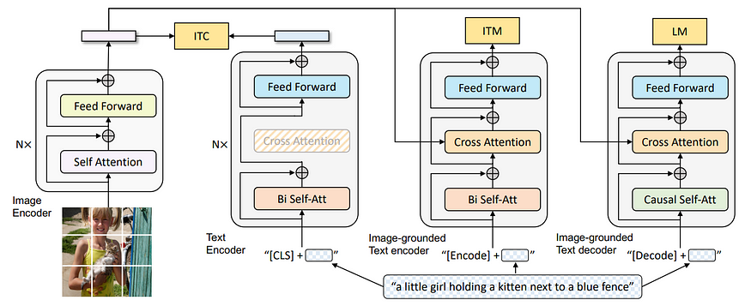
BLIP (Bidirectional Encoder Representations from Transformers)
Is a powerful image-text model that excels in tasks like image captioning, visual question answering, and image retrieval.
It leverages the transformer architecture, a neural network known for its effectiveness in processing sequential data, to jointly encode images and text.

Slide 22
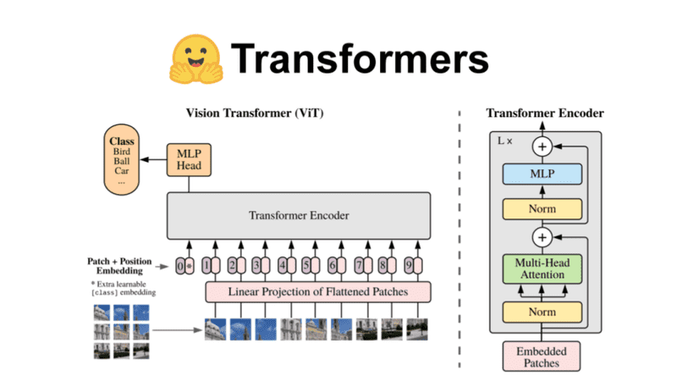
Hugging Face Library
Is a powerful open-source library in Python that provides easy access to state-of-the-art pre-trained models and tools for natural language processing (NLP) and other machine learning tasks.

Slide 23
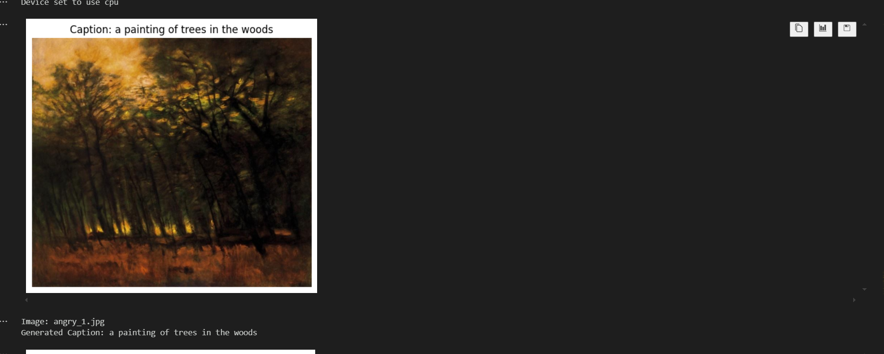
Implementation
Used in Image Captioning
captioning_pipeline = pipeline("image-to-text", model="Salesforce/blip-image-captioning-base", device=-1
Output

Slide 24
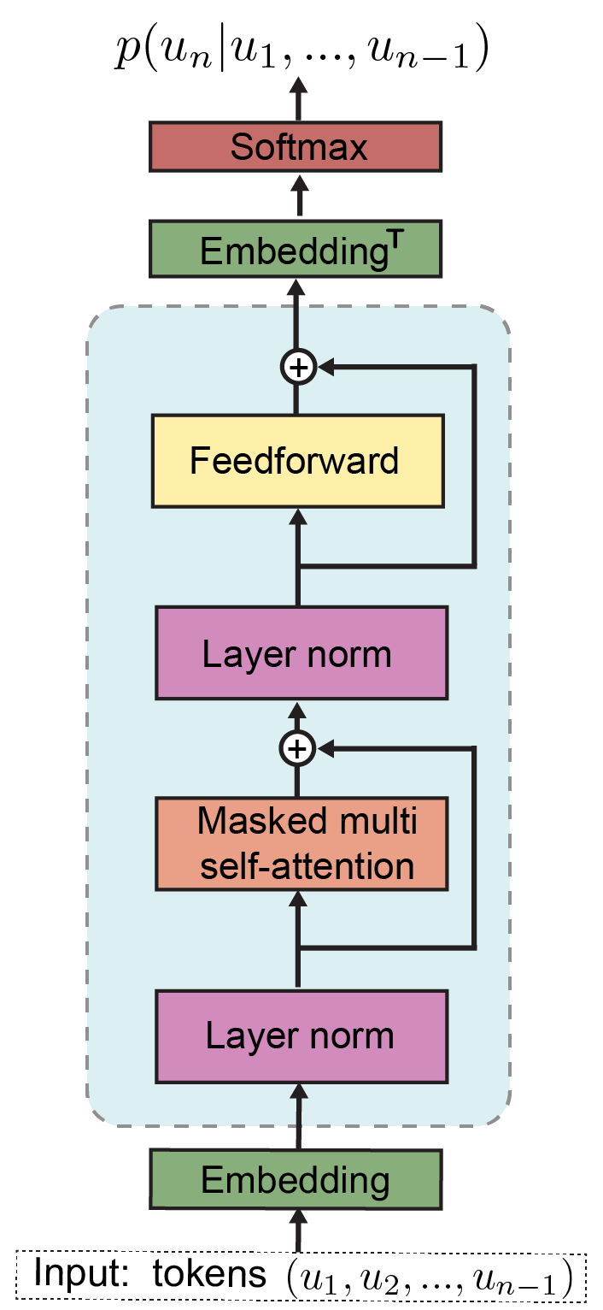
GPT-2 Model
Is a large language model developed by OpenAI, known for its ability to generate human-like text, translate languages, write different kinds of creative content, and answer your questions in an informative way
Disadvantages
Limited Understanding of Music Theory and Lack of Musical Expertise
Advantages
1) Lightweight Model (distilgpt2)
2)Resource Efficiency
3)Faster Inference
Notes:
Certainly, let's break down the model depicted in the image and discuss what "tokens" represent.
Model Overview:
The image illustrates a simplified architecture of a Transformer decoder, a key component in many natural language processing models, including the famous GPT-2 model. The decoder is responsible for generating sequential output, such as translating text, summarizing documents, or generating captions.
Key Components:
Input: Tokens (u1, u2, ..., Un-1)
Tokens: These are the fundamental units of language processed by the model. They can be individual words, sub-word units (like WordPiece), or even characters, depending on the specific tokenizer used.
The input to the decoder is a sequence of tokens representing the previous part of the output sequence. For example, in text generation, it could be the initial words or phrases that the model has already generated.
Embedding:
Each input token is converted into a dense vector representation (embedding) that captures its semantic meaning.
Masked Multi-Head Self-Attention:
This layer allows the model to weigh the importance of different input tokens when generating the next output token.
The "masked" part ensures that the model only attends to previous tokens in the sequence, preventing it from looking ahead into future tokens.
Layer Normalization:
This layer normalizes the output of the self-attention layer, improving the stability and performance of the model.
Feed-Forward Layer:
This layer applies a non-linear transformation to the output of the previous layers, introducing non-linearity into the model's computations.
Layer Normalization:
Another layer normalization step follows the feed-forward layer.
EmbeddingT:
This layer transforms the output of the feed-forward layer back into the original token space.
Softmax:
The final softmax layer produces a probability distribution over the vocabulary, indicating the likelihood of each possible token as the next output.
In essence:
The Transformer decoder generates the next token in the sequence by:
Processing the previous tokens using self-attention to understand their relationships.
Applying a series of transformations and normalization layers to refine the representation.
Generating a probability distribution over the vocabulary and selecting the most likely next token.
This process is repeated iteratively to generate the complete output sequence.
Let me know if you would like to explore any specific aspect of the Transformer decoder or have further questions!

Slide 25
Implementation
Output

Slide 26
Datasets

Slide 27
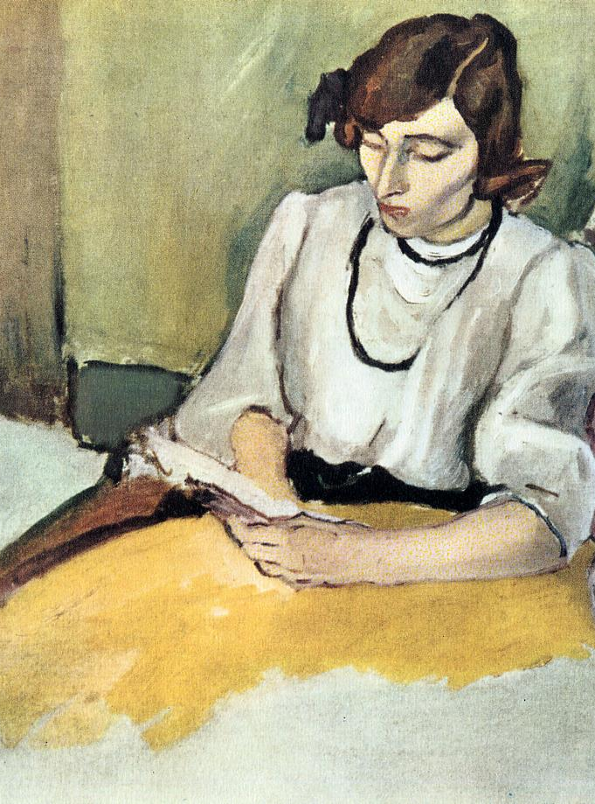
Emotion Painting Music Dataset
Focus on Multimodal Emotion
Open Access.
Is created and maintained by Queen Mary University of London, suggesting a strong academic foundation and potential for ongoing research and development within the university
Can be for Both music and images
Emotion Painting Music Dataset

Slide 28
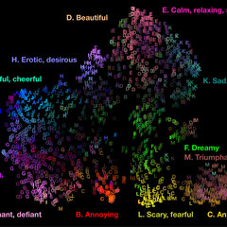
Mirex Emotion Dataset
Consists of
903-30 second clips. The files are organized in five folders (clusters) and subfolders (representing their labels/subcategories).
764 lyric files in txt format.
196 MIDI files.
Multi-modal MIREX Emotion Dataset

Slide 29
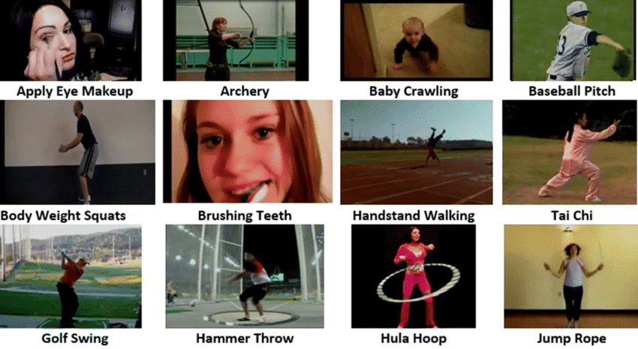
UCF101 Videos
Is a widely used benchmark dataset in computer vision, specifically for action recognition in video data. It was introduced to evaluate algorithms and models for understanding human actions in realistic scenarios.
Contains 13,320 realistic video clips across 101 diverse action classes with 320x240 resolution, collected from YouTube
UCF101 Videos

Slide 30
Accomplishments and Next Step

Slide 31

Accomplishments
1)Prepared Datasets
2)Genertated Captions from Emotion Painting music dataset using BLIP
3)Generated music from Mirex Emotion dataset using

Slide 32
What’s Next
Enhance music by adding models like MuseGAN
1
Try it on real time or videos
3
Use another model for caption enhancement like Jukebox by OpenAI
2

Slide 33


